Slide 1
Governor’s Office of Science, Innovation, and Technology

Slide 2
BEST BROADBAND SOLUTIONS AND SOURCES FOR SUSTAINABLE COMMUNITIES

Slide 3
What do I need? Wired versus wireless versus satellite

Slide 4
FIBER OPTICS

Slide 5
Coaxial and dsl

Slide 6
MICROWAVE

Slide 7
SATELLITE

Slide 8
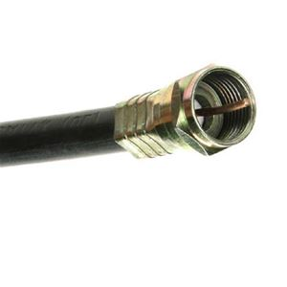
Advantages and Disadvantages of Wired Solutions
Connection Type | Advantages | Disadvantages
 | Extremely High Bandwidth Longer Distance Resistance to Electromagnetic Interference Low Security Risk Small Size and Light Weight | Fragile Difficult to install Cost Attenuation and Dispersion Special Equipment
 | Sufficient Frequency Range Greater Channel Capacity Greater Bandwidth Lower Error Rates | Deployment Noise Interference High Installation Cost Susceptible to Damage
 | Open Phone Lines No Additional Wiring Security Better than DIAL-UP!!!!! | Proximity Busy Lines Slower Uploads
FIBER
COAXIAL
DSL

Slide 9
Advantages and Disadvantages of Wireless Solutions
Connection Type | Advantages | Disadvantages
 | Able to transmit large quantities of data Relatively low costs Use of repeaters can extend data transfers | Needs Line of Sight Subject to electromagnetic Interference Signal degraded by weather
 | Low cost to maintain Good alternative in remote areas | Expensive to launch Requires Line of Sight Voice and Video jitter or buffering common Signal degraded by weather
MICROWAVE
SATELLITE

Slide 10
WHOLE COMMUNITY CONNECTIVITY APPROACH

Slide 11
Broadband Infrastructure Planning

Slide 12
The Planning Process
Form Action Committee & Gather Data
Write Statement of Need and Evaluation Criteria
Engage Private Sector Providers
Receive Responses
Decisions

Slide 13
Form and Gather
Form Broadband Action Committee
Surveys
Community feedback
Mapping of county/city owned broadband assets
County and municipal government current broadband demand

Slide 14
Statement of Need and Evaluation Criteria
Unserved areas
Underserved areas
Community broadband demand
Business development demand
Economic development demand
Grants available to assist

Slide 15
Engage Private Sector
Service Providers
Meetings
Create competitive edge
Presentations by service providers to respond to needs
Combine state and community projects with service providers

Slide 16
Receive Responses
Calculate and evaluate
Plan strategies
Prioritize
Seek grant funds to assist

Slide 17
Make Decisions
What are my broadband options?
Who do we engage?
So how much will this cost?
How do we pay for this?
EVERY COUNTY IS DIFFERENT

Slide 18
UNIVERSAL SERVICE
The E-Rate Program

Slide 19
Telecommunications PROGRAM
What is the E-rate Program?
One of the four Universal Service Fund programs
Provides discounts for schools and libraries
Discounts range from 20-90%
Based on National School Lunch Program(NSLP) eligibility
$3.9 Billion available each year

Slide 20
Telecommunications PROGRAM
What does E-rate Support?
PROVIDES FUNDING FOR:
Telecommunications (excluding Voice services)
Internet access
Networking hardware
Basic maintenance of networking hardware
Managed services

Slide 21
Telecommunications PROGRAM
How do I participate in E-rate?
As an Applicant:
Seek bids on eligible services
Award contracts
Apply for E-rate funding
Answer questions from the program administrator
Receive approval
Begin work and invoice USAC

Slide 22
Telecommunications PROGRAM
How do I participate in E-rate?
As a Service provider:
Review Request For Proposals(RFP)
Award contracts
Support the application for E-rate funding
Assist in answering questions from the program administrator
Receive approval
Begin work and invoice USAC

Slide 23
Telecommunications PROGRAM
How has Nevada Benefitted
from E-rate?
In the past five years, $40,378,759 has been approved by the E-rate program
Since the start of the E-rate program, $146,174,321 has been approved

Slide 24
Telecommunications PROGRAM
What is Special Construction in the Eyes of E-rate?
Special construction includes:
Trenching/Digging
Hanging fiber
Pulling/Blowing fiber
Installing conduit
Special construction does not include:
Monthly recurring charges
Networking hardware

Slide 25
Telecommunications PROGRAM
Why is Special Construction Special?
The Federal Communications Commission(FCC) added a funding incentive to encourage states:
For states that provide matching funds up to 10%, the FCC through the E-rate program will provide an additional match fund up to 10%
Nevada Connect Kids Initiative:
Goal is to increase broadband Internet access, adoption and use of Internet
Governor Sandoval and OSIT received legislative approval of $2M to support special construction projects

Slide 26
Telecommunications PROGRAM
Special Construction Projects
Elko County School District
Funded for $921,000
10GB Fiber replacing 100MB Copper
Lyon County School District
Seeking $1.25M
10GB Fiber replacing Microwave

Slide 27
UNIVERSAL SERVICE
RURAL HEALTH CARE

Slide 28
rural healthcare Programs
TWO PROGRAMS
TELECOMMUNICATIONS PROGRAM
Funding based on urban rural cost differential
HEALTHCARE CONNECT FUND
Funding is a flat 65% discount

Slide 29
Telecommunications PROGRAM
TELECOMMUNICATIONS PROGRAM
PROVIDES FUNDING FOR:
Telecommunications –Connectivity
Telecommunications – Voice Services
DOES NOT PROVIDE FUNDING FOR:
Internet Access
Fees & Surcharges
Self-Provisioned Networks
Network Equipment

Slide 30
HEALTHCARE CONNECT PROGRAM
PROVIDES FUNDING FOR THE FOLLOWING SERVICES:
Internet access
Advanced telecommunications or information services for health information technology that:
Provides connectivity over private dedicated networks or the public Internet
Enables Health Care Providers(HCP) to post their own data
Interacts with stored data
Generates new data or communication

Slide 31
healthcare connect PROGRAM
PROVIDES FUNDING FOR NETWORK EQUIPMENT
Equipment required to light dark fiber
Equipment necessary to connect dedicated health care broadband networks or individual HCPs to middle mile or backbone networks
Computers, including servers and related hardware (e.g., printers, scanners, laptops) that are used exclusively for network management

Slide 32
Continued
Software used for network management, maintenance, or other network operations, and development of software that supports network management, maintenance, and other network operations
Costs of engineering, furnishing (i.e., as delivered from the manufacturer and installing network equipment)
Equipment that is a necessary part of the HCP owned facilities

Slide 33
healthcare connect program
DOES NOT PROVIDE FUNDING FOR:
Equipment not associated with an eligible service and that is not necessary to make an eligible service functional or to manage, control, or maintain an eligible service or a dedicated healthcare broadband network
Voice services

Slide 34
WHO IS ELIGIBLE TO PARTICIPATE?
Must be a non-profit entity or a public health care provider
Health Care Provider must be located in an FCC approved rural location

Slide 35
Who is eligible to participate?
HCP must be one of the following types of entities:
Post-secondary educational institution offering healthcare instruction, such as teaching hospital or medical school
Community health center or health centers providing healthcare to migrants
Local health departments or agencies
Community mental health centers
Not-for-profit hospitals

Slide 36
Who is eligible to participate?
HCP must be one of the following types of entities:
Rural health clinics
Consortia of HCPs consisting of one or more of the above entities
Dedicated emergency departments of rural for-profit hospitals
Part-time eligible entities located in facilities that are ineligible
Skilled nursing facilities

Slide 37
Who is eligible to participate?
WHO IS ELIGIBLE TO PARTICIPATE?
CONSORTIUM
A group of multiple sites that choose to request support as a single entity
Two or more Health Care Providers
50% or greater must be designated rural
Some services and equipment eligible only to consortiums

Slide 38
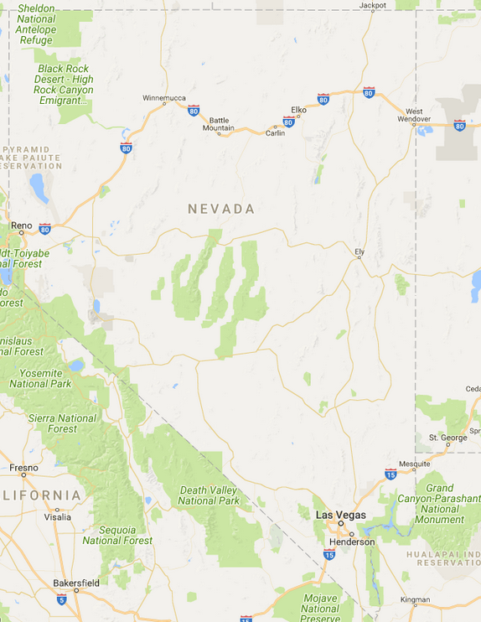
benefits FOR NEVADA
Connects Rural Health Care Providers to high speed broadband
Consortium of Health Care Providers
Reduced travel for patients and medical professionals
Video conference sessions with physicians, including specialists
Tele-Pharmacy capabilities

Slide 39
PARTICIPATE IN THE RURAL HEALTHCARE PROGRAM
HOW TO BEGIN IN THE PROGRAM:
Determine HCP eligibility - NOW
Form consortium for cost-benefits - NOW
Determine which services are needed - NOW
Prepare & submit RFP, procurement period - NOW
Award contracts – AFTER PROCUREMENT PERIOD
Submit application - February 1, 2019

Slide 40
Millennials the new workforce

Slide 41
PERCEPTION

Slide 43
PERCEPTION

Slide 45
NOW FOR THE REAL TRUTH

Slide 46
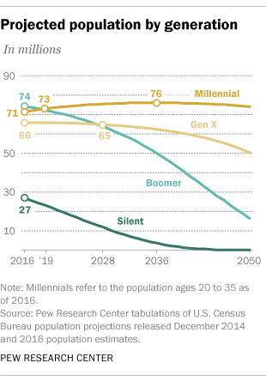

Slide 47
VALUES

Slide 48
VALUES
Challenge - Embrace complexity. Do not like being bored
Learning - Gains knowledge through variety of tasks
Career Goals - Must be able to see their career path
Feedback - Needs to hear it often
Flexibility - Expects level of flexibility. Likes idea of working remote
Results Oriented - Likes to be evaluated on finished work

Slide 49
VALUES
Transparency - Structure and systems. How is performance measured?
Access - Open and constant communication from boss.
Social Interaction - Prefers teams. Workplace is a social space.
It Matters - Pursues careers that align with desire to make a difference.
Social Platforms - Great at organizational growth through social platforms.

Slide 50
Did you know?

Slide 51
¼ of US population
Best educated young adults in US history
63.3% of US Execs will retire within the next 5 years
$1.3 trillion in annual buying power
87% use 2-3 devices daily
Touch smartphone at least 45 times daily
Spend 25 hours online weekly
33% rely on blogs to buy
7 times more likely to give their personal information
75% work for companies that give back
84% do not trust traditional advertising
54% want a start up or have already started a business
83% use social media

Slide 52
thank you SWITCH data center wndd E-rate Central Mighty River Mel Van Patten-moderator Caroline mcintosh reece keener nokia ndot usda millennial guests

Slide 53
CONTACTS E-rate Central – 886.801.7880 eric flock, Mel Van Patten, Becky Rains mighty river – 919.247.5121 joe freddoso nokia – 408.737.0900 Rohit Bhanot ndot – 775.888.7867 Denise Inda USDA – 702.716.8771 Lu Torres

Slide 54
Governor’s Office of Science, Innovation, and Technology
Jojo Myers Campos 775.687.0993 100 N. Stewart St., Suite 220, Carson City, NV 89701

